Slide 1

GROCERY DASH
Ali Atis, Rayan Bouazzi, Emre Guzelordu, Zayne Lumpkin, Landon Pattison, Christopher Shepard, Yusef Wadi

Slide 2
OBJECTIVE
The objective of our project is to revolutionize the way people buy their groceries. With our program; the user will be able to choose a grocery store nearby and add all the necessary items to their bucket and then the program will create the shortest path to gather all of the items in the bucket depending on the real time inventory data of the chosen store thus reducing the amount of time people spend in grocery stores trying to find all of the items.

Slide 3
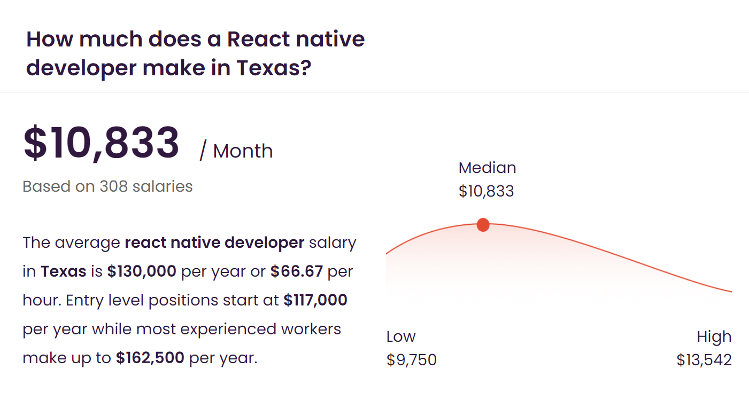
COST
Estimated cost of hardware products : $2596.00
Estimated cost of software products : $100.00
Estimated cost of personnel : $479,890.00
TOTAL : $ 482,586.00

Slide 4
PROJECT TIMELINE
The project will start on January 10, 2023 and it will end on November 17, 2023. It will take about 10 months and 7 days which is shorter than the average time it takes for a project to be completed.

Slide 5
FUNCTIONAL REQUIREMENTS
User shall be able to choose a store and make a list of products and get a best path for the products
User shall be able to make a list of products and get the closest store that has all the products in stock and then get a path for that store.
The user should be able to add the product to their cart
The user should be able to remove a product from their cart
The user should be able to find the location of a particular product
The system shall generate the fastest route after all the products have been added to the cart

Slide 6
NON-FUNCTIONAL REQUIREMENTS
The app should be available in all platforms: android, IOS, PC, MacOS, etc.
The fastest route should be generated within 10 seconds.
The entire program should occupy less than 2GB of space.
The program will only need to operate between the times when the average store is open.
The program should be developed in less than 12 months.
The program should not share the home address of the user, the store they are shopping from, etc.
The program will only charge $9.99 for the premium and nothing else. Regular users will not be charged.
*Assuming there are no environmental regulations and government regulations.

Slide 7
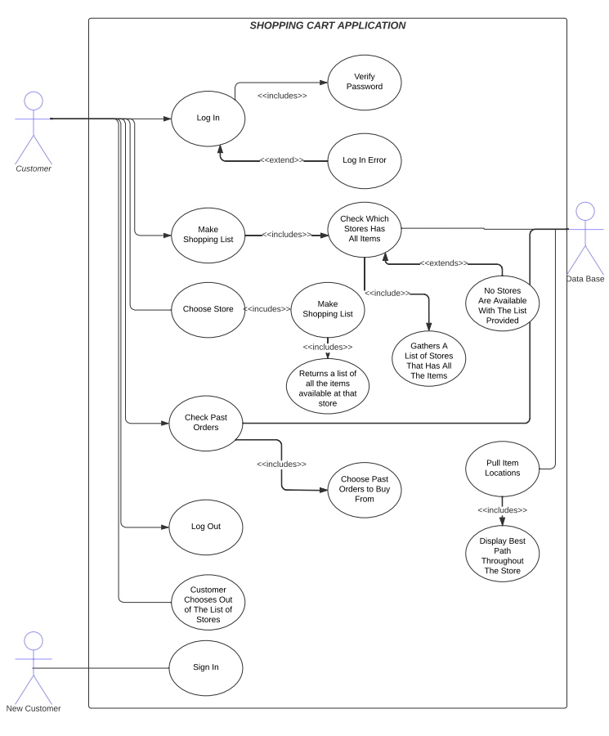
USE - CASE DIAGRAM
The use case diagram for our program.

Slide 8
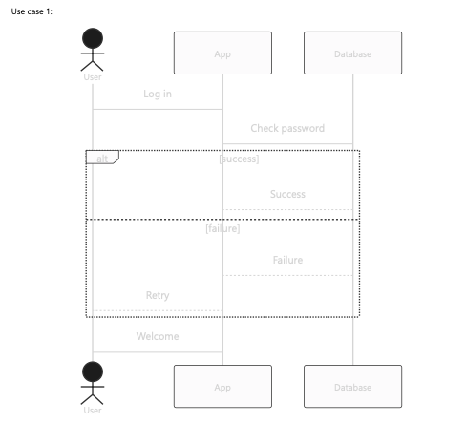
SEQUENCE DIAGRAM
The sequence diagram for one of our log in use case

Slide 9
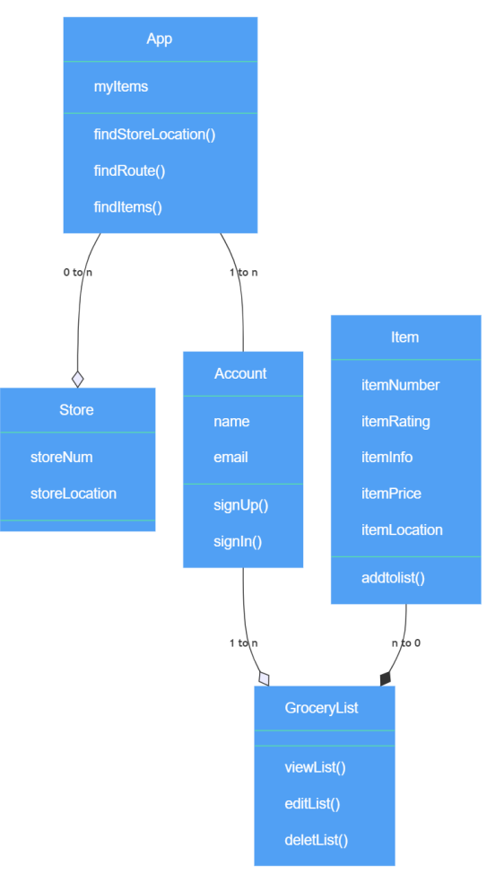
CLASS DIAGRAM
The class diagram for our application

Slide 10
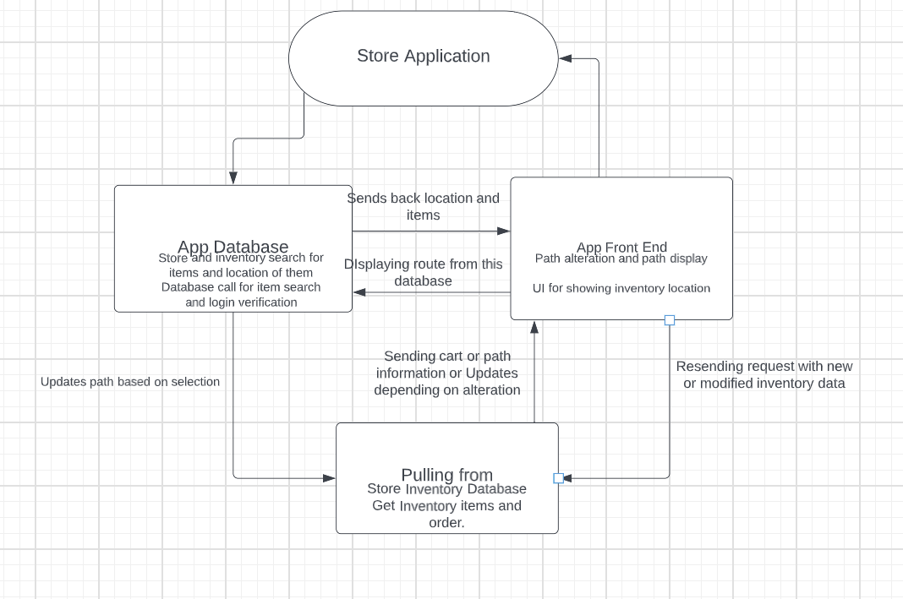
ARCHITECTURAL DESIGN
The Architectural design for our project which is MVC

Slide 11
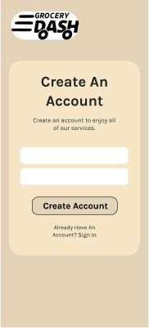
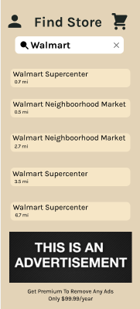
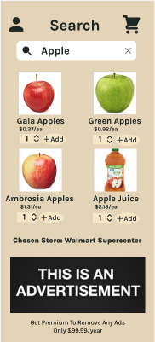
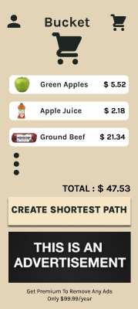
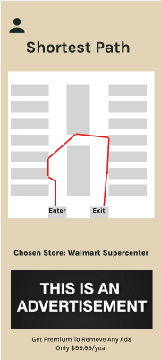
DEMO

